Slide 1



BuildFest 2.0
PS-18
AI-Powered Heavy Rainfall Forecasting and Urban Flood Early Warning System for Indian Cities
Software: AI/ML, Data Science and GIS | Disaster Management, Smart Automation and Climate Resilience
Team: TryAgain | Project: AURA-Autonomous Urban rainfall and Assessment system
Vanshikaa ▪ Niharika ▪ Palak
Electronics and Communication
Guru Nanak Dev University

Slide 2
PROPOSED SOLUTION
Solution Overview
Key Features
AURA-Flood: an AI-powered spatial intelligence platform that turns rainfall forecasts, historical weather, terrain, drainage and flood records into street-level waterlogging risk.
Ingests IMD and NWP data plus SRTM elevation, runs an AI flood-risk engine, and outputs Low / Moderate / High risk with location-based alerts.
Interactive civic map with dynamic risk polygons (Low, Moderate, High)
Rainfall trend panel: expected accumulation over the next 6 hours
Vulnerability pinpoints for historic waterlogging spots and critical chokepoints
Location-based alerts, with an uncertainty visualiser and official-forecast disclaimer
How It Addresses the Problem
Unique / Innovative Aspects
Closes the localisation gap: 10 m street-level risk grids instead of vague city-wide warnings.
Covers every deliverable: dashboard, interactive map, 3-level risk classes, alert demo and model evaluation.
Built for residents, campus administrators and disaster-management teams in Indian cities.
Elevation Risk Curve: SRTM basin volume vs. incoming rain to estimate time-to-threshold per grid.
Statistical uncertainty bound shown with every prediction, never hidden.
Experimental outputs clearly separated from official IMD / NDMA warnings.
Lightweight interface that works on low-bandwidth networks during storms.
AURA by TryAgain
BuildFest 2.0 | PS-18 | Guru Nanak Dev University
2 / 6

Slide 3
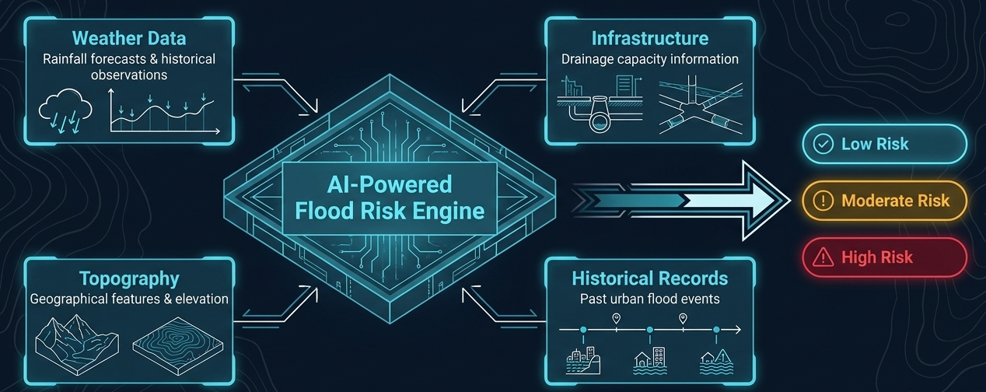
SYSTEM DESIGN
Proposed Methodology
Block Diagram / System Architecture
Requirement analysis: gather IMD observations, NWP forecasts, SRTM DEM, drainage data and past flood records.
Modelling: Elevation Risk Curve plus ML engine for risk estimation.
Implementation: 3-tier build (AI microservice, orchestration API, civic interface).
Testing and validation: replay historical events and compare with observations.
Working Principle
Flowchart / Workflow
Ingest NWP rain volume, then compute SRTM DEM basin volume for each grid cell.
Compute time-to-threshold against the Elevation Risk Curve; classify Low / Moderate / High.
ML engine (Python, Pandas, GeoPandas) refines estimates and generates a statistical uncertainty bound.
Input
IMD, NWP, SRTM, flood records
Process
Normalise and grid-align data
Model
Elevation Risk Curve + ML
Output
Risk map, trends, alerts
AURA by TryAgain
BuildFest 2.0 | PS-18 | Guru Nanak Dev University
3 / 6

Slide 4
IMPLEMENTATION AND TESTING
ARMSS
Technologies / Components Used
Testing Methodology
Python, Pandas, GeoPandas (AI microservice); Spring Boot (orchestration API)
React + Bootstrap civic interface; SRTM DEM, IMD data, NWP forecasts
Replay simulated and historical flood events to demonstrate location-based alerts.
Validate predictions against observed rainfall and flood records; compare with current city-level forecasts as baseline.
Implementation / Prototype Status
Key Performance Metrics / Results
Phase 1 (Hackathon T0-T24): data ingestion pipelines, Python microservice trained on limited IMD data, Spring Boot scaffolding.
Phase 2 (T24-T48): React UI, live mapping integration, location-based alert simulation.
Phase 3 (post-deployment): evaluate against observations, document limitations, tune confidence bounds for Indian urban environments.
Metric | Target | Result
Spatial resolution | 10 m street-level grid | Pending
Risk classification | Low / Moderate / High | Pending
Rainfall trend horizon | Next 6 hours | Pending
Model vs observations | Evaluated, limits documented | Pending
Uncertainty display | Shown on every prediction | Pending
AURA by TryAgain
BuildFest 2.0 | PS-18 | Guru Nanak Dev University
4 / 6

Slide 5
BENEFITS & IMPACTS
Target Users / Beneficiaries
Real-World Applications
Residents and Municipal Corporation
Campus administrators and disaster-management teams
Urban flood early warning for Indian cities
Safer transport, infrastructure and campus operations planning
Scalability / Future Potential
Expected Impact
Global expansion beyond Indian cities
Mobile app and new features
Less disruption to transport and damage to infrastructure
Better public safety through informed, hyper-local decisions
Business Model Blueprint
Value Proposition
Revenue Model
Major Costs
Solves a problem
Provides value
Unique choice
One-time subscription
Easy to handle
Enterprise licensing
API & cloud
Development
Marketing
AURA by TryAgain
BuildFest 2.0 | PS-18 | Guru Nanak Dev University
5 / 6

Slide 6
"When the rain becomes city-wide emergency, AURA comes into play."
THANK YOU
by Team TryAgain
Questions and Discussion

